Slide 1
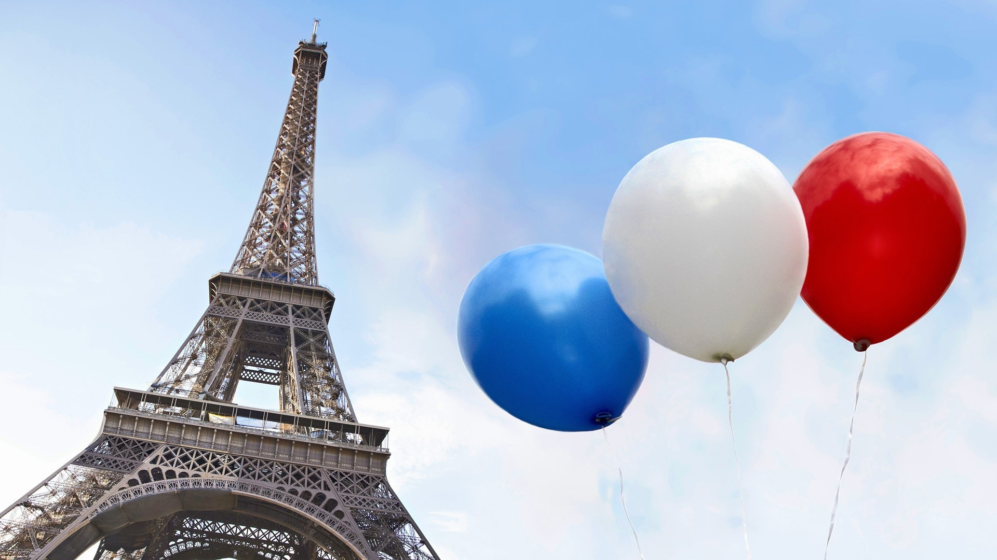
Bastille Day
Le 14 Juillet
La Fête Nationale Française

Slide 2
What is Bastille Day?
One of the most important dates in France is the 14th July. In French, this date is le quatorze juillet or La Fête Nationale Française.
In English, it is called Bastille Day.
Why is it called Bastille Day? Well, a long time ago, there was a prison in Paris called Bastille Saint-Antoine.

Slide 3
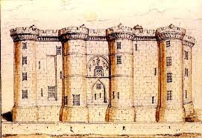
Every year, on le 14 juillet (the 14th July) France celebrates the moment, in 1789, when the angry people of Paris broke into the prison and set the prisoners free. This event is called 'the storming of the Bastille’ and was the start of The French Revolution.

Slide 4
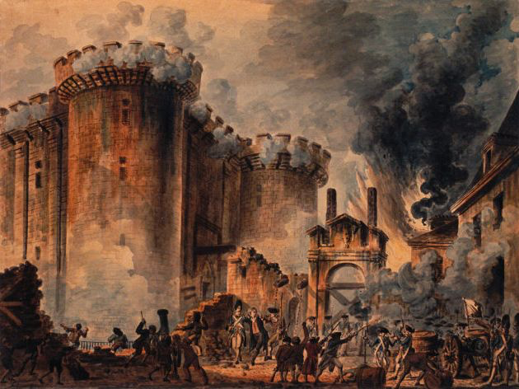

Slide 5
Why did they do this?
The people of Paris were incredibly angry. They were poor and hungry and were often put in prison without a fair trial.
They attacked the Bastille, freed the prisoners and stole the weapons stored inside.
To show their support for the rebellion people started to wear red, white and blue – the colours of to modern day French flag.

Slide 6
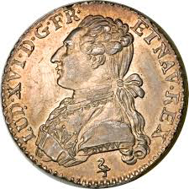
What happened next?
The poor people were now in charge. The king tried to escape but he was caught because a border guard recognised his face from a coin!

Slide 7
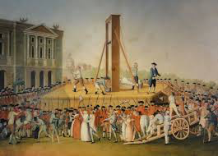
What happened next?
The royal family and their rich friends were put into prison and were tried for treason. They were found guilty and King Louis XVI and his Queen Marie Antoinette were executed in 1793.

Slide 8
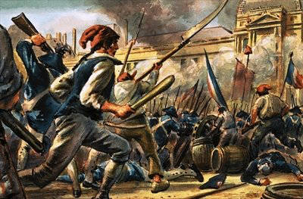
What happened next?
The French Revolution lasted for 10 years until 1799. By that time over 40,000 people had been executed. Some of these people had done very bad things and some were completely innocent.

Slide 9
Why do people celebrate Bastille Day?
Every year on the 14th July, France remembers the brave people who fought for freedom and justice for everybody in French society.
As a result of their bravery, the monarchy was abolished and everybody, no matter how poor, was given importance and rights.
That is why the motto of France is Liberté, Égalité, Fraternité, (Freedom, Equality, Brotherhood).

Slide 10
If you go to France on holiday you might see this picture. It is the symbol used by the French Government.
The woman in the image is called Marianne. She is the French symbol of liberty.

Slide 11
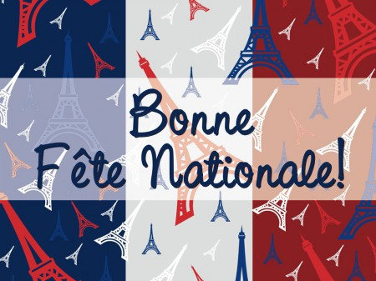
How do people celebrate Bastille Day?
The French flag flies everywhere and there are celebrations and fireworks all over France.
The President of France holds a garden party at his residence in Paris.
People take the day off work because it is an official holiday. It is a great time for children and families.
La Tour Eiffel a des ailes
https://www.youtube.com/watch?v=Hldea1MoWbQ

Slide 12
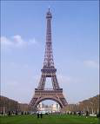
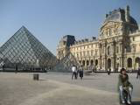
How do people celebrate Bastille Day?
To celebrate 100 years after the French Revolution started, France’s most famous landmark was opened in 1889 – the Eiffel Tower!
To celebrate 200 years the glass pyramid at the Louvre art gallery was opened in 1989!

Slide 13
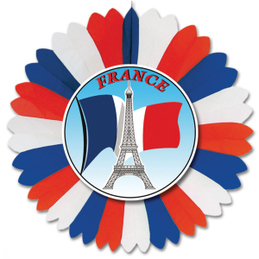
Activity
http://www.teteamodeler.com/activite/collage/cocarde-14-juillet.asp
Make your own French Revolution Rosette

Slide 14
Success Criteria
Follow the instructions to make the French Revolution rosette.
Only use the colours red, white and blue.
In the middle, choose a French phrase to write, some ideas:
Vive la revolution!
Liberté, égalité, fraternité
La fête nationale française

