Slide 1
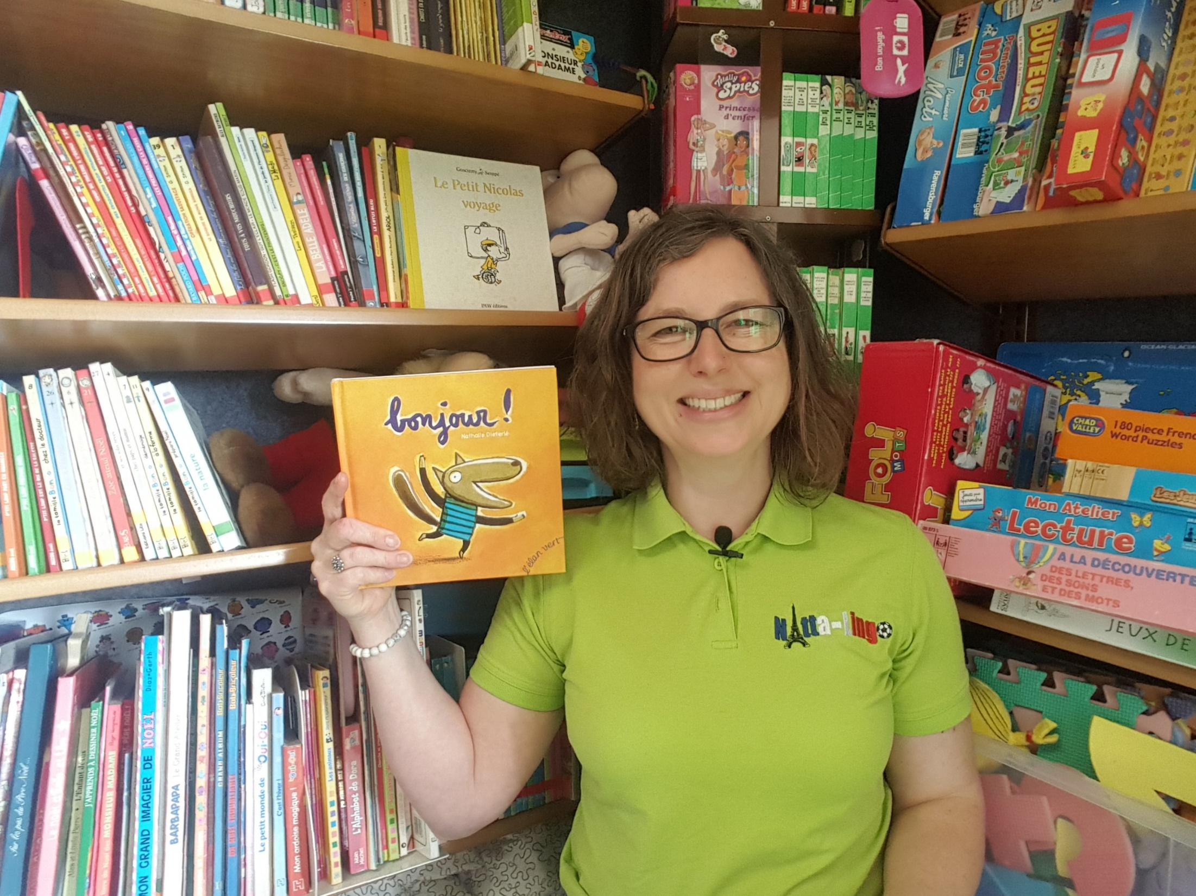

Slide 2
Here are the animals and things Petit Loup greets.
Sort them into 2 columns: singular and plural.
How do you know which is which?
Petites fourmis
Hérissons
Poissons
Arbre
Ciel
Cailloux

Slide 3
Singular
Arbre
Ciel
Plural
Petites fourmis
Hérissons
Poissons
Cailloux (most words that end in –ou take an “x” in the plural)

Slide 4
Here are the verbs in the 3rd person singular.
Which ones are –er verbs? How do you know?
Se lève
Ouvre
Crie
Descend
Chuchote
Court
S’écrie
Est

Slide 5
Which ones are –er verbs? How do you know?
The verbs highlighted look like –er verbs as they end in
–e in the 3rd person; “ouvre” is an exception though.
Se lève
Ouvre – infinitive: ouvrir
Crie
Descend
Chuchote
Court
S’écrie
Est

Slide 6
Write the infinitives of the highlighted –er verbs.
What do they mean in English?
Se lève – se lever = to get up
Ouvre – infinitive: ouvrir = to open
Crie –crier = to shout
Descend
Chuchote – chuchoter = to whisper
Court
S’écrie – s’écrier = to exclaim
Est

Slide 7
Write the infinitives of the other verbs.
What do they mean in English?
Se lève – se lever = to get up
Ouvre – infinitive: ouvrir = to open
Crie – crier = to shout
Descend – descendre = to go down
Chuchote – chuchoter = to whisper
Court – courir = to run
S’écrie – s’écrier = to exclaim
Est – être = to be

