Slide 1
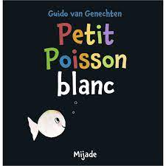
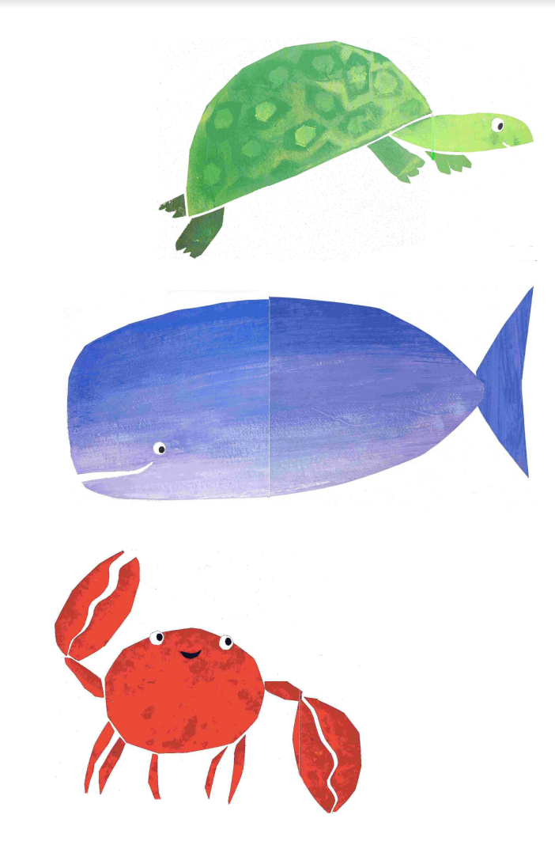
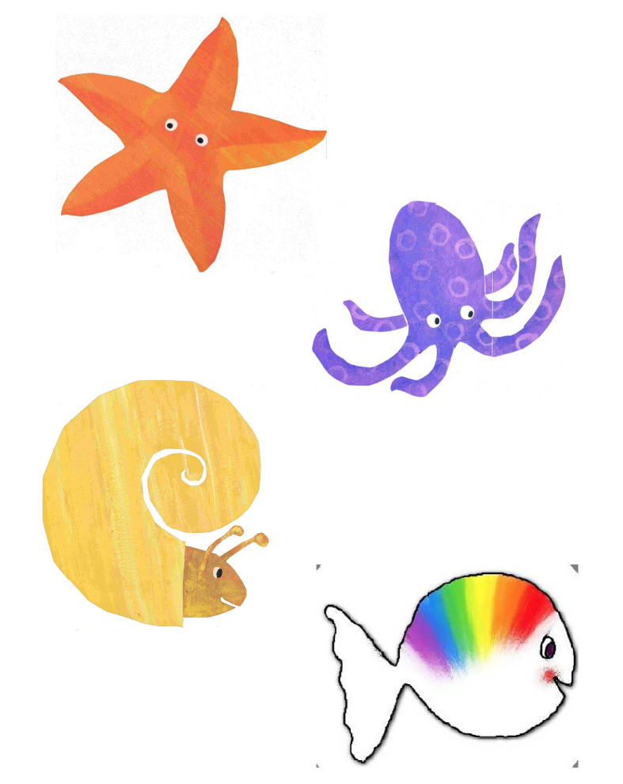
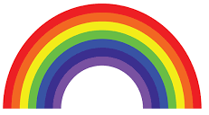
Petit poisson blanc
L’étoile de mer est orange
La tortue est verte
La pieuvre est mauve
La baleine est bleue
L’escargot est jaune
Petit poisson blanc est toutes les couleurs de l’arc en ciel
Le crabe est rouge
Click on book to open link to story video in French on youtube
Notes:
Cover Fri 28 Jan

Slide 2
https://nattalingo.co.uk/petit-poisson-blanc/\
Language of text: French
Type of text: picture book
Author or source: Guido van Genechten, published by Mijade
Intended age of students: Key Stages 1/2
Source reference: 9782871427001
Approaches:
I look at the cover with the children; most of them will probably understand the title, but I tell them that it is about a fish looking for its mum, and during the first reading they have to tell me “oui” or “non”, whether it is its mum or not.
During the second reading, the children will also repeat the names of the animals, eg “c’est un crabe”; during the third reading they will be able to say what colours the animals are (stop just before you say the colour, the children have to say it, if they know their colours); they can also all join in with the question: “Est-ce la maman de Petit Poisson Blanc ?”, or you could split the class in 2 and have half the class asking the question, half the class answering it, and vice-versa.
Rationale:
This book is very simple and colourful, yet you can do a lot with it. It can be used with very young children who will just join in with “oui” or “non” but will be emotionally engaged with the story; it can be read to older primary school children who will look closely at the language used and the grammar points (as mentioned below).
It even introduces fun phrases like “mais non, voyons”, which the children will enjoy using in the classroom afterwards.
Outcomes:
This story can be used to introduce or reinforce colours, animals, masculine and feminine, or even adjectival agreement.
As Clare Seccombe suggests in her Changing Phase blog, once they are very familiar with the story the children can write their own version of it and choose a different hero as well as different animals to go and see; they could all be forest animals for example. They can pick from a list of animals or practise their dictionaries skills and make a minibook. They need to be aware of adjectival agreements if they are to include colours too.
Topics or themes:
colours; sea animals; all animals
Grammar:
masculine and feminine; adjectival agreement; word order; asking “is it?” in French
How much time required:
1-2 lessons

Slide 3
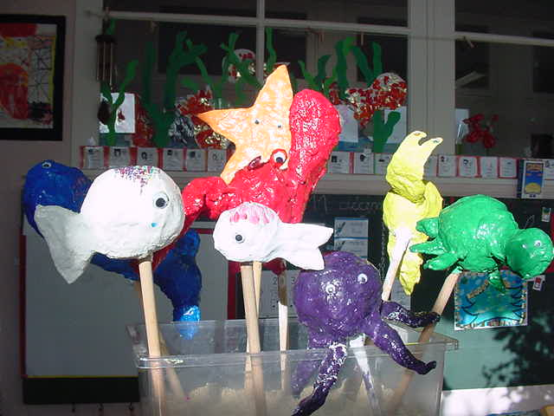
Lesson 1
Read story - explain its a book about - a baby fish looking for his mummy
Ask pupils repeat
Names of animals (already encountered in Coucou baby)
Colours
Q & A - ask if its petit poisson blancs mummy (oui/ non - thumbs up/down)
Language practiced | Thinking
Animal names | “Est-ce la maman de Petit Poisson Blanc ?”, “oui” or “non”,
colours

Slide 4
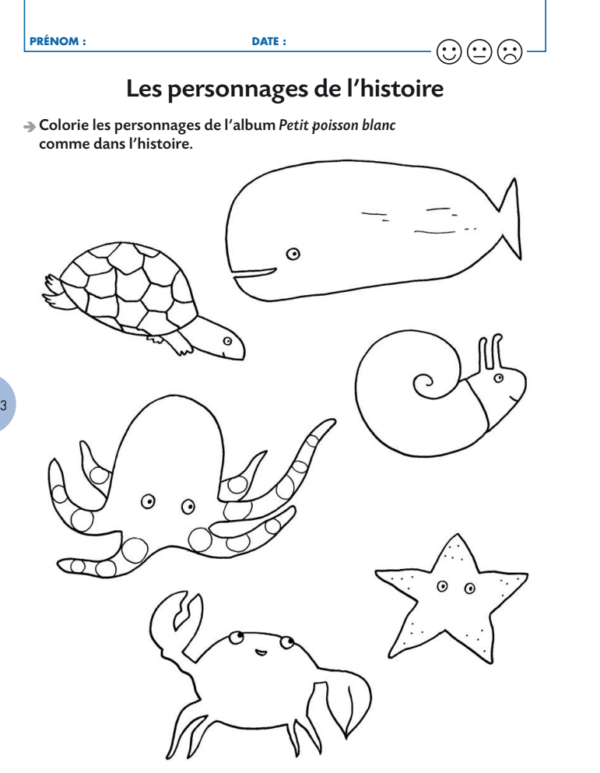
Lesson 2/3
Re- read
Reinforce colours
Colouring pages
Laminated cards of each creature for Qui a…
(use imagier pdf cards)

Slide 6
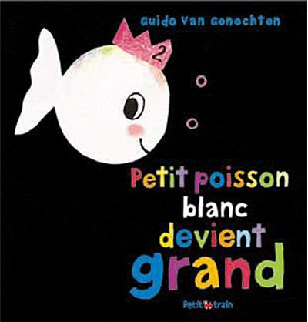
Lesson 3 - new story
Read
Reinforce sea creatures (+ couple of new ones) & introduce
La fête = party
Anniversaire = birthday
Grand = big / petit = small
Gros = fat/ mince = slim
Heureux = happy / triste = sad
Long = long/ court = short
Salle = dirty /propre = dirty
Droite = straight / corbé = curved
https://youtu.be/bV8UPqWpoK8

